Slide 1
Homework 3
Luke Roe

Slide 2
Credit Risk Analytics via Machine learning
Problem 1

Slide 3
Background
Fairly Unbalanced:
1540 samples (rows) are labeled as ’good credit’
130 samples are labeled as ’ bad credit’
There are six variables:
variable 1: Working capital / Total Assets (WC_TA)
variable 2: Retained Earnings / Total Assets (RE_TA)
variable 3: Earnings Before Interests and Taxes / Total Assets (EBIT_TA)
variable 4: Market Value of Equity / Book Value of Total Debt (MVE_BVTD)
variable 5: Sales / Total Assets (S_TA)
variable 6: Industry sector labels from 1-12

Slide 4
Objectives
Use K Nearest Neighbors to classify the dataset
Use K-fold to properly segment the dataset
Test multiple distance types with different scalars
Use confusion matrix and other metrics to analyze results

Slide 5
Methods
Create a class called CreditData that will contain the following methods and functions:
split_data(self, test_size=0.2):
k_fold(self, k=10):
normalize(self, scaler):
knn(self, X_train, y_train, X_test, y_test, k=5, metric='minkowski'):
plot_confusion_matrix(self, cm):
get_metrics(self, y_test, y_pred_proba, cm):

Slide 6
Metrics Function
def get_metrics(self, y_test, y_pred_proba, cm):
tn, fp, fn, tp = cm.ravel()
accuracy = (tp + tn) / (tp + tn + fp + fn)
precision = tp / (tp + fp)
recall = tp / (tp + fn)
f1 = 2 * (precision * recall) / (precision + recall)
fpr, tpr, thresholds = roc_curve(y_test, y_pred_proba)
roc_auc = auc(fpr, tpr)
auprc = average_precision_score(y_test, y_pred_proba)
d_index = np.log2(1+accuracy) + np.log2(1 + ((recall + precision)/2))
return [accuracy, precision, recall, f1, d_index, roc_auc, fpr, tpr, auprc]

Slide 7
Note:
For brevity, I have only included the results for the first fold of the k-folds split, however the full code is provided in the notebook.
If I didn’t do this, this pptx would be over 100 slides long.

Slide 8
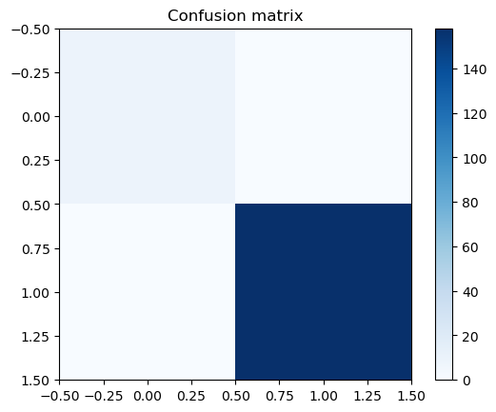
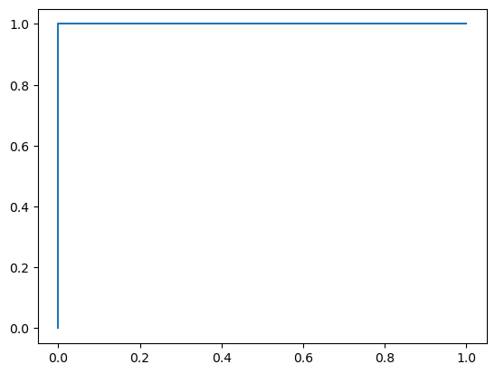
Euclidean: Standard Scalar
accuracy: 1.0
precision: 1.0
recall: 1.0
f1: 1.0
d_index: 2.0
roc_auc: 1.0
auprc: 1.0

Slide 9

Euclidean: MinMax Scalar
accuracy: 1.0
precision: 1.0
recall: 1.0
f1: 1.0
d_index: 2.0
roc_auc: 1.0
auprc: 1.0

Slide 10

Euclidean: Robust Scalar
accuracy: 1.0
precision: 1.0
recall: 1.0
f1: 1.0
d_index: 2.0
roc_auc: 1.0
auprc: 1.0

Slide 11

Euclidean: MaxAbs Scalar
accuracy: 1.0
precision: 1.0
recall: 1.0
f1: 1.0
d_index: 2.0
roc_auc: 1.0
auprc: 1.0

Slide 12

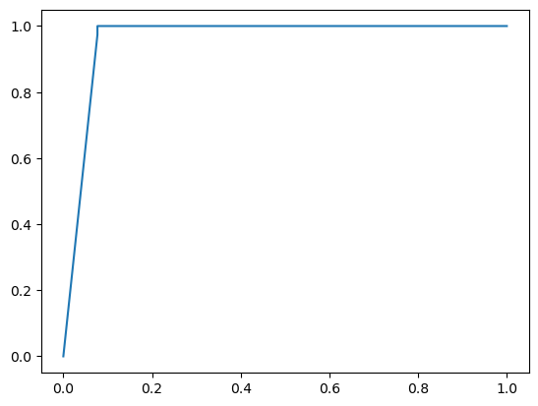
Cosine: Standard Scalar
accuracy: 0.9940119760479041
precision: 0.9935483870967742
recall: 1.0
f1: 0.9967637540453074
d_index: 1.993345268537237
roc_auc: 0.9605394605394606
auprc: 0.9933811063907307

Slide 13

Cosine: MinMax Scalar
accuracy: 0.9940119760479041
precision: 0.993421052631579
recall: 1.0
f1: 0.9966996699669968
d_index: 1.9932992674093064
roc_auc: 1.0
auprc: 1.0

Slide 14

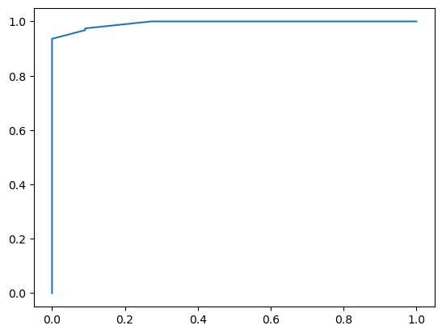
Cosine: Robust Scalar
accuracy: 0.9700598802395209
precision: 0.9934640522875817
recall: 0.9743589743589743
f1: 0.9838187702265372
d_index: 1.966587161151004
roc_auc: 0.9932983682983683
auprc: 0.999340977184281

Slide 15

Cosine: MaxAbs Scalar
accuracy: 1.0
precision: 1.0
recall: 1.0
f1: 1.0
d_index: 2.0
roc_auc: 1.0
auprc: 1.0

Slide 16

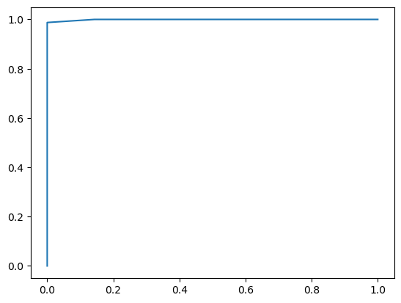
Correlation: Standard Scalar
accuracy: 0.9940119760479041
precision: 0.9937888198757764
recall: 1.0
f1: 0.9968847352024921
d_index: 1.9934321238105404
roc_auc: 0.9991071428571429
auprc: 0.9999223602484472

Slide 17

Correlation: MinMax Scalar
accuracy: 0.9880239520958084
precision: 0.9865771812080537
recall: 1.0
f1: 0.9932432432432432
d_index: 1.9864857392114768
roc_auc: 1.0
auprc: 1.0

Slide 18

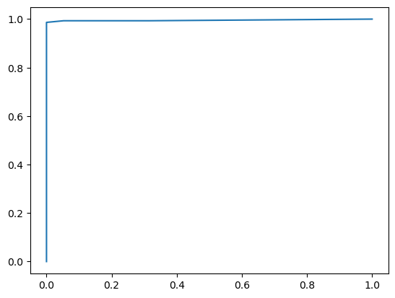
Correlation: Robust Scalar
accuracy: 0.9880239520958084
precision: 0.9932432432432432
recall: 0.9932432432432432
f1: 0.9932432432432432
d_index: 1.9864529174931262
roc_auc: 0.9953769559032717
auprc: 0.9991856134334691

Slide 19
Correlation: MaxAbs Scalar
accuracy: 1.0
precision: 1.0
recall: 1.0
f1: 1.0
d_index: 2.0
roc_auc: 1.0
auprc: 1.0

Slide 20
Chebyshev: Standard Scalar (got same results for all scalers)
accuracy: 1.0
precision: 1.0
recall: 1.0
f1: 1.0
d_index: 2.0
roc_auc: 1.0
auprc: 1.0

Slide 21
Chebyshev: MinMax Scalar
accuracy: 1.0
precision: 1.0
recall: 1.0
f1: 1.0
d_index: 2.0
roc_auc: 1.0
auprc: 1.0

Slide 22
Chebyshev: Robust Scalar
accuracy: 1.0
precision: 1.0
recall: 1.0
f1: 1.0
d_index: 2.0
roc_auc: 1.0
auprc: 1.0

Slide 23
Chebyshev: MaxAbs Scalar
accuracy: 1.0
precision: 1.0
recall: 1.0
f1: 1.0
d_index: 2.0
roc_auc: 1.0
auprc: 1.0

Slide 24
Seuclidean: Standard Scalar (got same results for all scalers)
accuracy: 1.0
precision: 1.0
recall: 1.0
f1: 1.0
d_index: 2.0
roc_auc: 1.0
auprc: 1.0

Slide 25

Seuclidean: MinMax Scalar
accuracy: 1.0
precision: 1.0
recall: 1.0
f1: 1.0
d_index: 2.0
roc_auc: 1.0
auprc: 1.0

Slide 26
Seuclidean: Robust Scalar
accuracy: 1.0
precision: 1.0
recall: 1.0
f1: 1.0
d_index: 2.0
roc_auc: 1.0
auprc: 1.0

Slide 27

Seuclidean: MaxAbs Scalar
accuracy: 1.0
precision: 1.0
recall: 1.0
f1: 1.0
d_index: 2.0
roc_auc: 1.0
auprc: 1.0

Slide 28
Query PM 2.5
Problem 2

Slide 29
Objectives
Cluster data by year using bisecting kmeans
Cluster data using knn

Slide 30
Methods
Make a class called PM25Data with the methods and functions:
def split_data(self, test_size=0.2):
def do_knn(self, X_train, y_train, X_test, y_test, k=5, metric='minkowski'):
def plot_confusion_matrix(self, cm):

Slide 31
Split data function
def split_data(self, test_size=0.2):
# use year 2010 - 2013 as training data and 2014 as test data
X_train = self.data[self.data['year'] < 2014].drop(columns=['year', 'target'])
y_train = self.data[self.data['year'] < 2014]['target']
X_test = self.data[self.data['year'] == 2014].drop(columns=['year', 'target'])
y_test = self.data[self.data['year'] == 2014]['target']
return X_train, y_train, X_test, y_test

Slide 32
KMeans
I manually did kmeans with each year as a new fold in k-fold and got the following (very poor) accuracy results:
2010: 0.41947843282659747
2011: 0.3930527888446215
2012: 0.37371910789632307
2013: 0.3733579165706384
2014: 0.3747835122965016

Slide 33
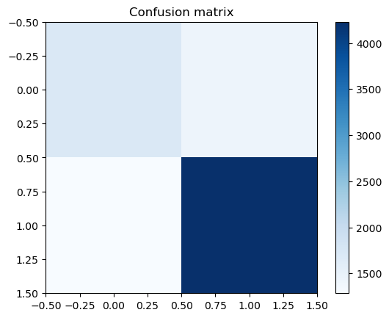
Euclidean Distance

Slide 34

Correlation Distance

Slide 35

Cosine Distance

Slide 36
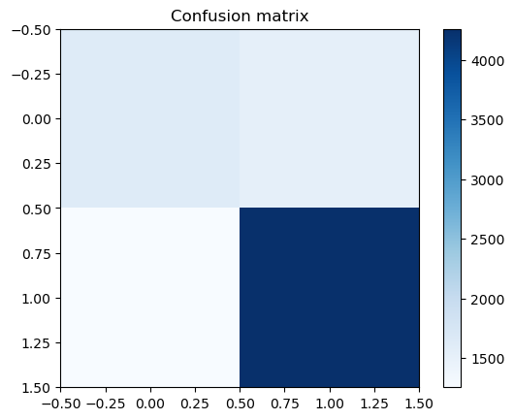
Chebyshev Distance

Slide 37
Seuclidean Distance

Slide 38
Conclusions
Results are fairly poor (below 50%) for kmeans, maybe a different scalar would work better, but I think that MinMax would produce the best results.
For Knn, according to the confusion matrices, most fall into True Positive or True Negative, with fairly good accuracy.

